Slide 1
Original Proposed Content
Title: Effective Data Visualization for Actuaries
Session Description:
Actuaries often need to regularly communicate trends, diagnostics, and findings to stakeholders (other actuaries, their business partners, or clients).
Two questions arise:
How do we create visualizations that let actuaries focus on interpreting rather than doing?
How do we re-structure these visualizations to tell a better story?
In this session Brian and I will examine some common actuarial analysis problems (e.g. loss development, trend/inflation, mix shift exhibits, and model diagnostics) through the lens of visualization. Using R’s `ggplot2` package, we’ll show how these visualizations can be improved to better communicate the story. For example, reserve loss development can be manipulated with `dplyr` to show cumulative losses on the x-axis and incremental amounts on the y-axis to better highlight the loss development factor. After demoing a few visualization examples, we’ll show how some formatting tricks can be used to make your visualizations look polished.
Learning Objectives:
Demonstrate when alternative representations of common actuarial visualizations are helpful
Basic use of the `ggplot2` package
When and how to use non-data formatting to customize a visualization for your audience
Session Format: Concurrent Session, 50-60 minutes
Theme: Navigate
Applicable Areas: Actuarial Toolkit: Programming Software, Data Manipulation Tools, and Data Visualization Tools
Knowledge Level: Level 2: General Knowledge of the Subject (6-9 years)
Interactive Elements: There will be one or two discussion prompts, as well live voting to compare different means of visualizing data analysis
To Be Removed. For Reference Only.

Slide 2
Ideas for Interactivity
Familiarity with R
“Which chart is easier to interpret”
Test Bar/Line bias (https://bit.ly/3ymQ1eE)

Slide 3
Effective Data Visualization for Actuaries
Brian Fannin
Jordan Bonner

Slide 4
Antitrust Notice
The Casualty Actuarial Society is committed to adhering strictly to the letter and spirit of the antitrust laws. Seminars conducted under the auspices of the CAS are designed solely to provide a forum for the expression of various points of view on topics described in the programs or agendas for such meetings.
Under no circumstances shall CAS seminars be used as a means for competing companies or firms to reach any understanding – expressed or implied – that restricts competition or in any way impairs the ability of members to exercise independent business judgment regarding matters affecting competition.
It is the responsibility of all seminar participants to be aware of antitrust regulations, to prevent any written or verbal discussions that appear to violate these laws, and to adhere in every respect to the CAS antitrust compliance policy.

Slide 5
Agenda
Data Storytelling
Actuarial Visualization
Automating Actuarial Exhibits

Slide 6
Data storytelling

Slide 7
Visualizations should:
Be Easily Interpreted
Tell a Story

Slide 8
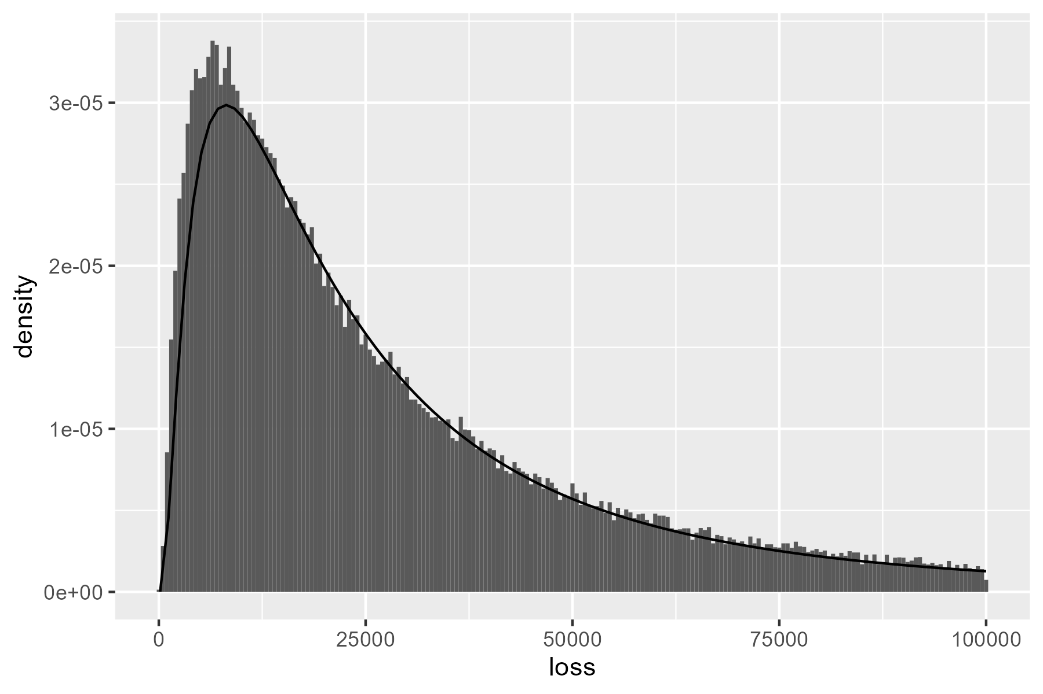
Initial Example: Fitted Severity
How can we improve upon this chart?
p <- data |>
geom_histogram(aes(x = loss, after_stat(density)) +
stat_function(fun = dlnorm,
args = list(meanlog = 10, sdlog = 1.0))

Slide 9
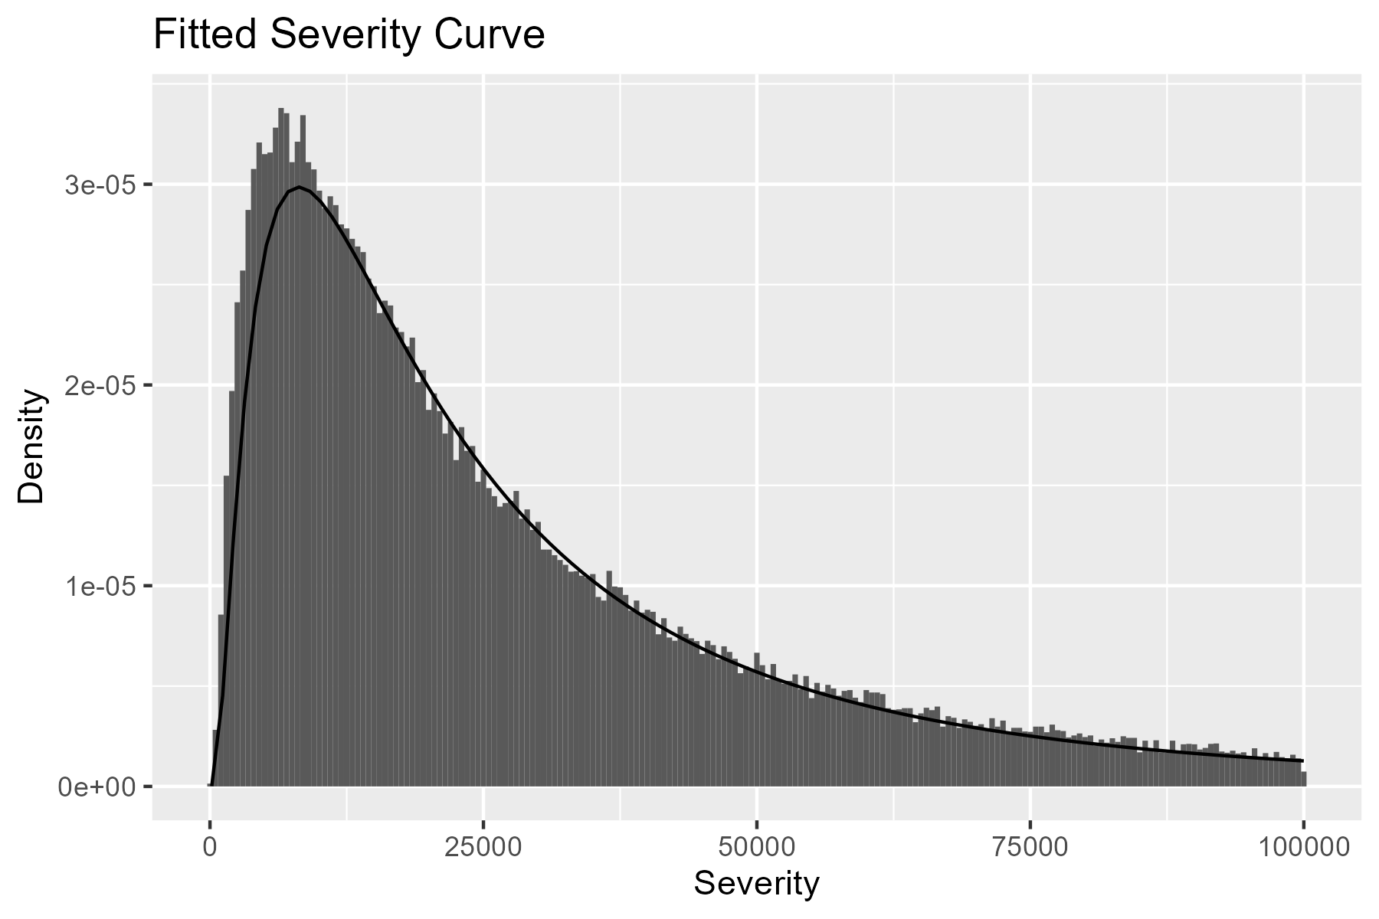
Titles & Renaming Variables
Adding a title and variable names goes a long way.
p <- p +
labs(
x = "Severity",
y = "Density",
title = "Fitted Severity Curve"
)

Slide 10
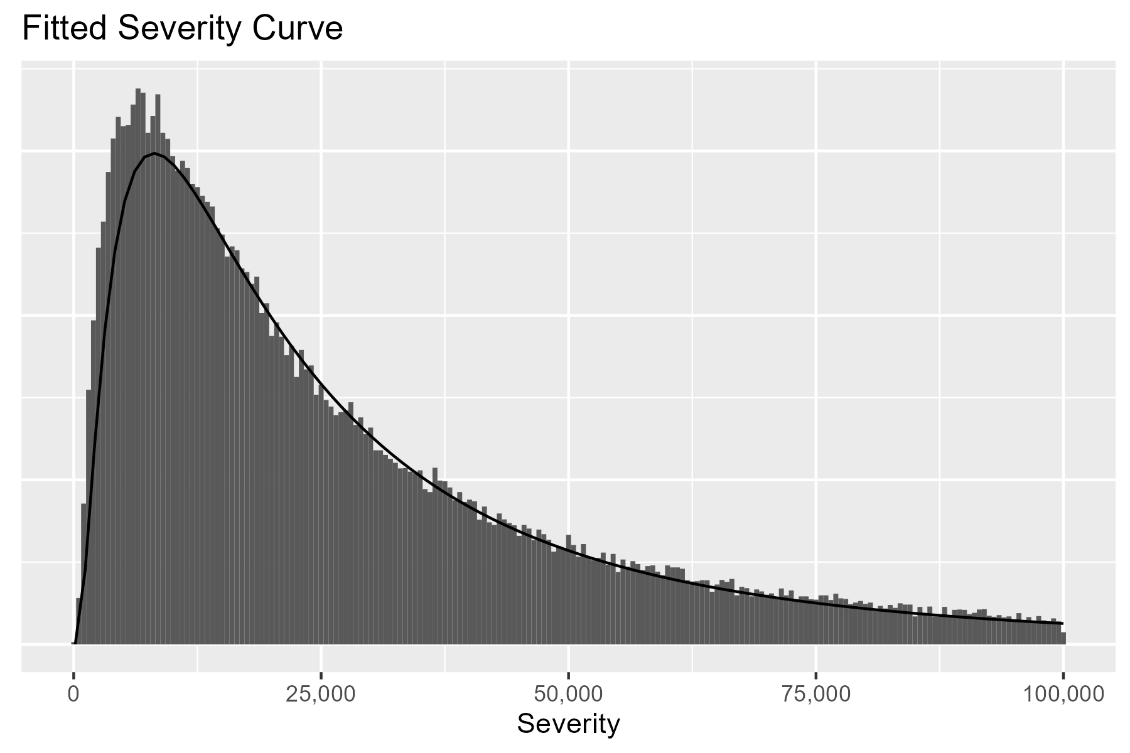
Cleaning Axes
We can change the x-axis labels and remove the y-axis.
p <- p +
scale_x_continuous(labels = scales::comma) +
theme(axis.text.y = element_blank(),
axis.ticks.y = element_blank(),
axis.title.y = element_blank())

Slide 11
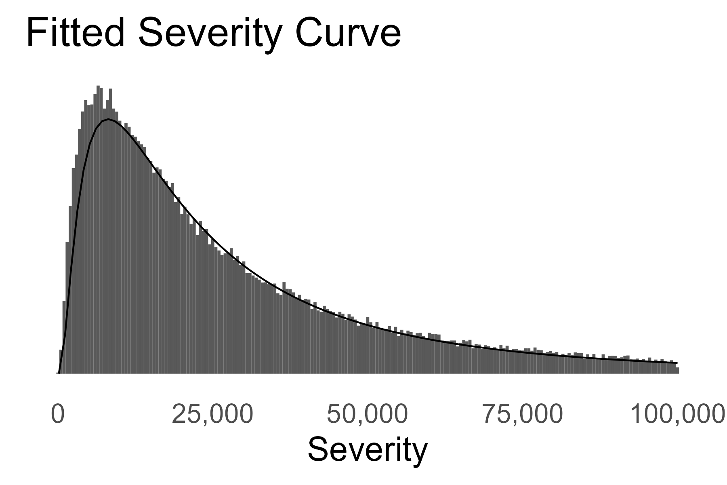
Text Size & Theme
We can increase text size and select a simpler theme.
p <- p +
theme_minimal(base_size = 20) +
theme(panel.grid.major = element_blank(),
panel.grid.minor = element_blank()) +
scale_x_continuous(labels = scales::comma) +
theme(axis.text.y = element_blank(),
axis.ticks.y = element_blank(),
axis.title.y = element_blank())

Slide 12
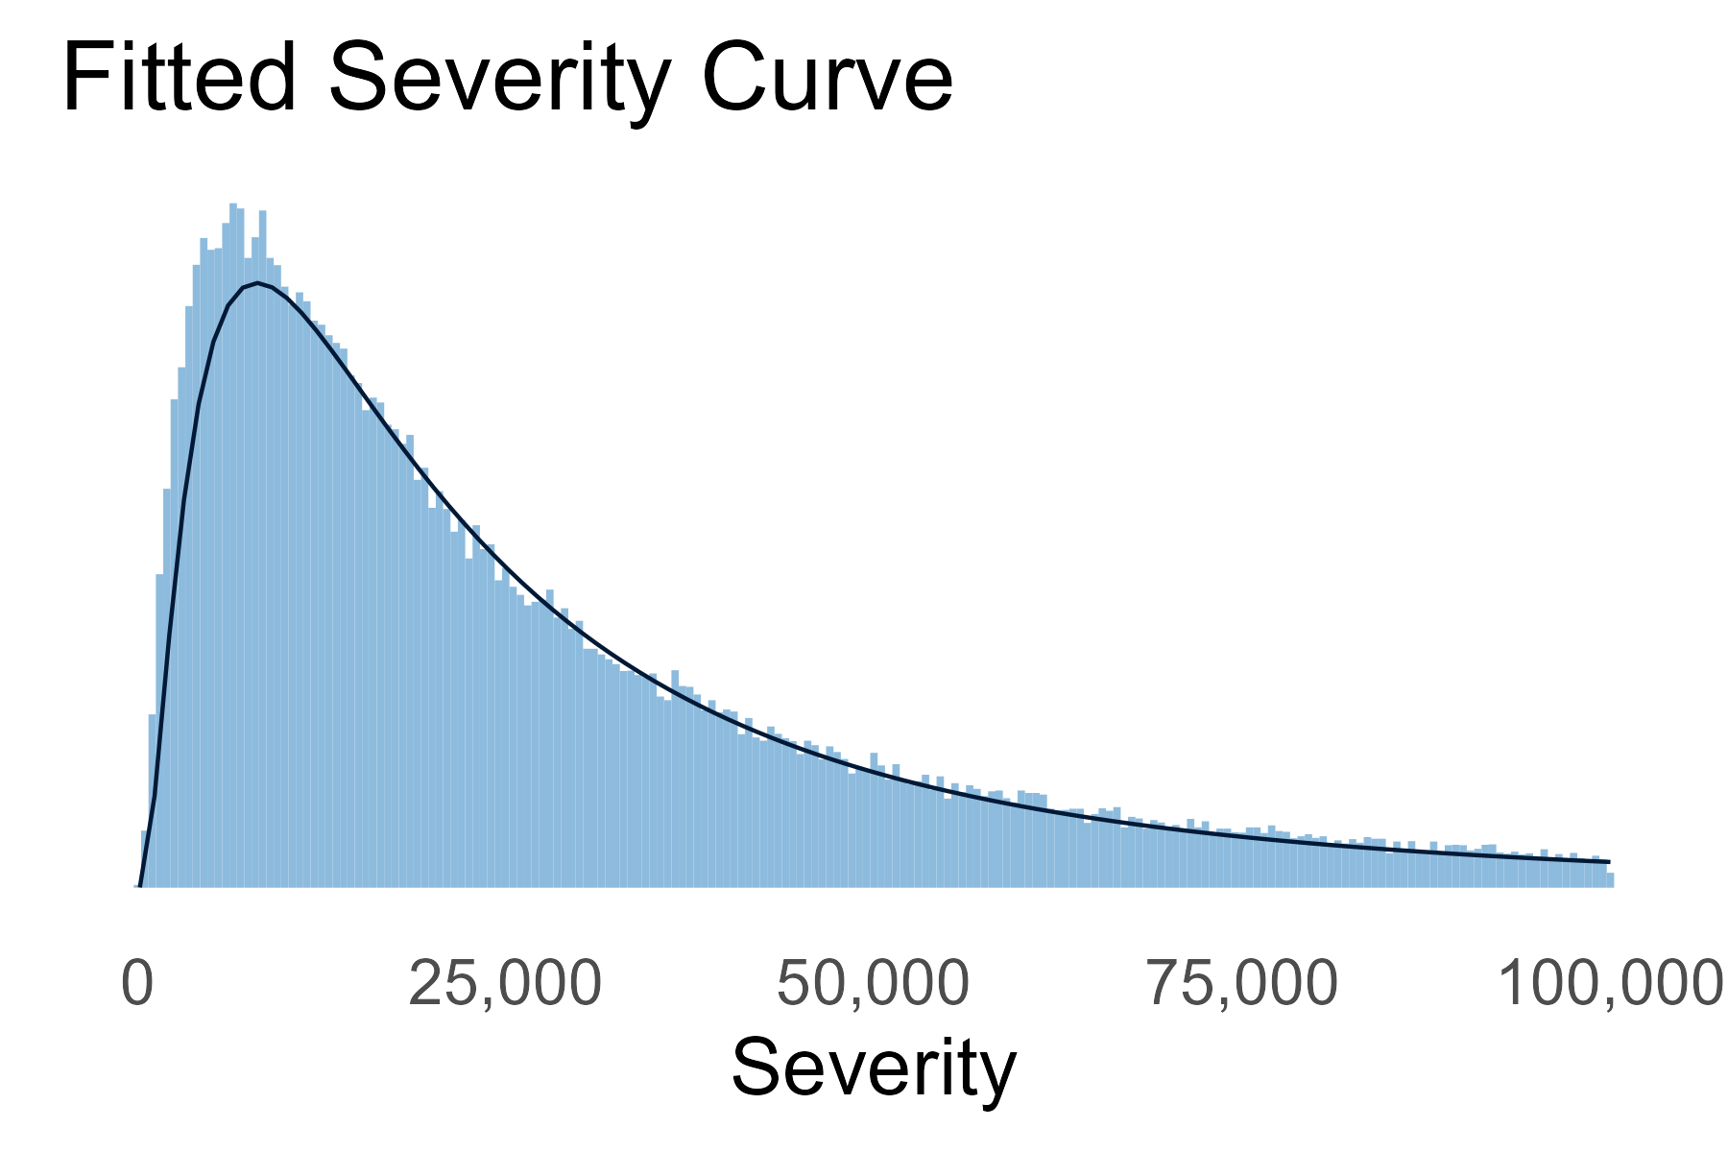
Color
We can also update the color, if desired.
...
geom_histogram(aes(x = loss, after_stat(density)),
fill = pal_CAS["light_blue"]) +
stat_function(fun = dlnorm,
args = list(meanlog = 10, sdlog = 1.0),
color = pal_CAS["dark_blue"]) +
...

Slide 13

Comparison

Slide 14
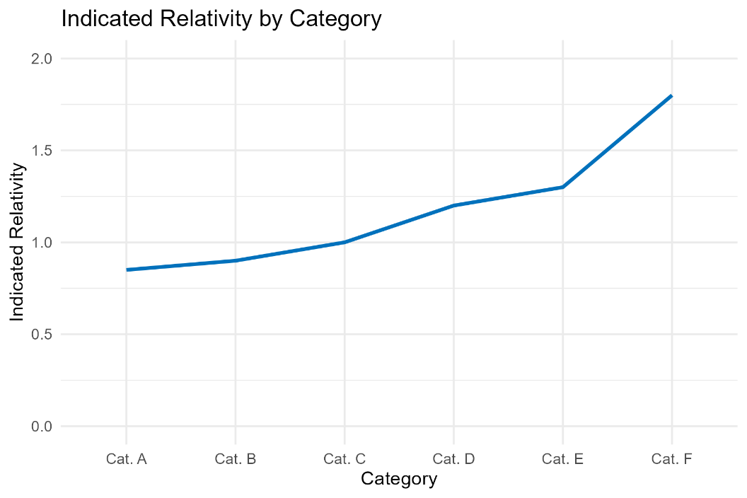
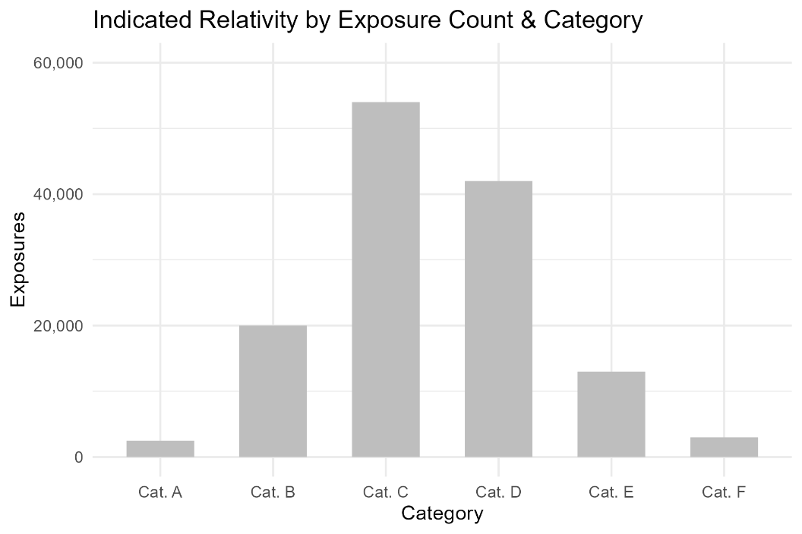
Two Axes vs Two Charts

Slide 15
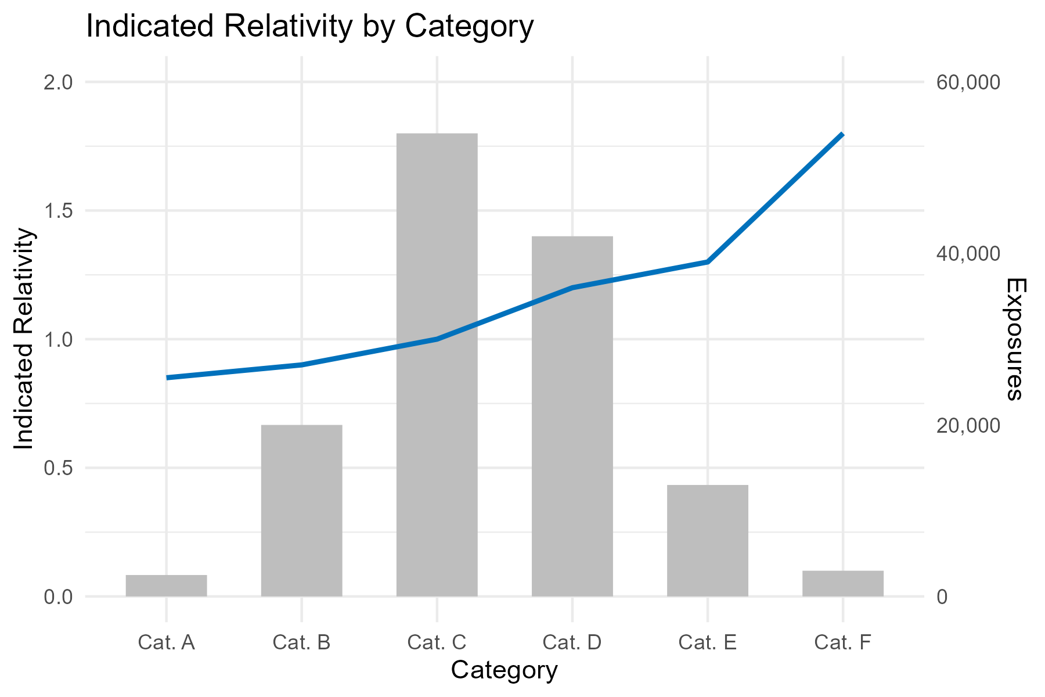
Two Axes vs Two Charts

Slide 16
Actuarial visualization

Slide 17
Common Actuarial Exhibits
Loss Development Triangles
Trend Selection
Rate Indications
Mix Shift Exhibits
Model Diagnostics

Slide 18
Loss Development Triangles

Slide 19
Loss Development Triangles

Slide 20
Trend Selection

Slide 21
Trend Selection

Slide 22
Rate Indications

Slide 23
Rate Indications

Slide 24
Mix Shift

Slide 25
Mix Shift

Slide 26
Model Diagnostics

Slide 27
Model Diagnostics

Slide 28
Automating actuarial exhibits

Slide 29







Typical Actuarial Analysis Pipeline
Database
Data Extract
Additional Data from Email
Ad Hoc Analysis
Ad Hoc Analysis
Stakeholder Presentation
Rate Indication
Actuarial Memo
Documentation

Slide 30


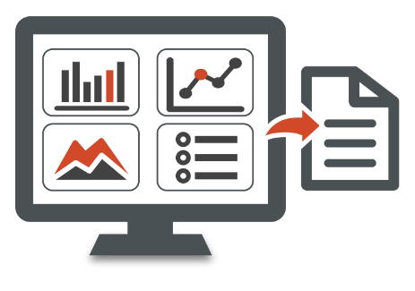
Simplified Actuarial Analysis Pipeline
Database
With rmarkdown:
Read in data directly from source
Separate “chunks” for each analysis
Self-documents
New data can flow through
Can also be used to create dynamic slides for presentations
All analysis kept in one place

Slide 31
Appendix

Slide 32
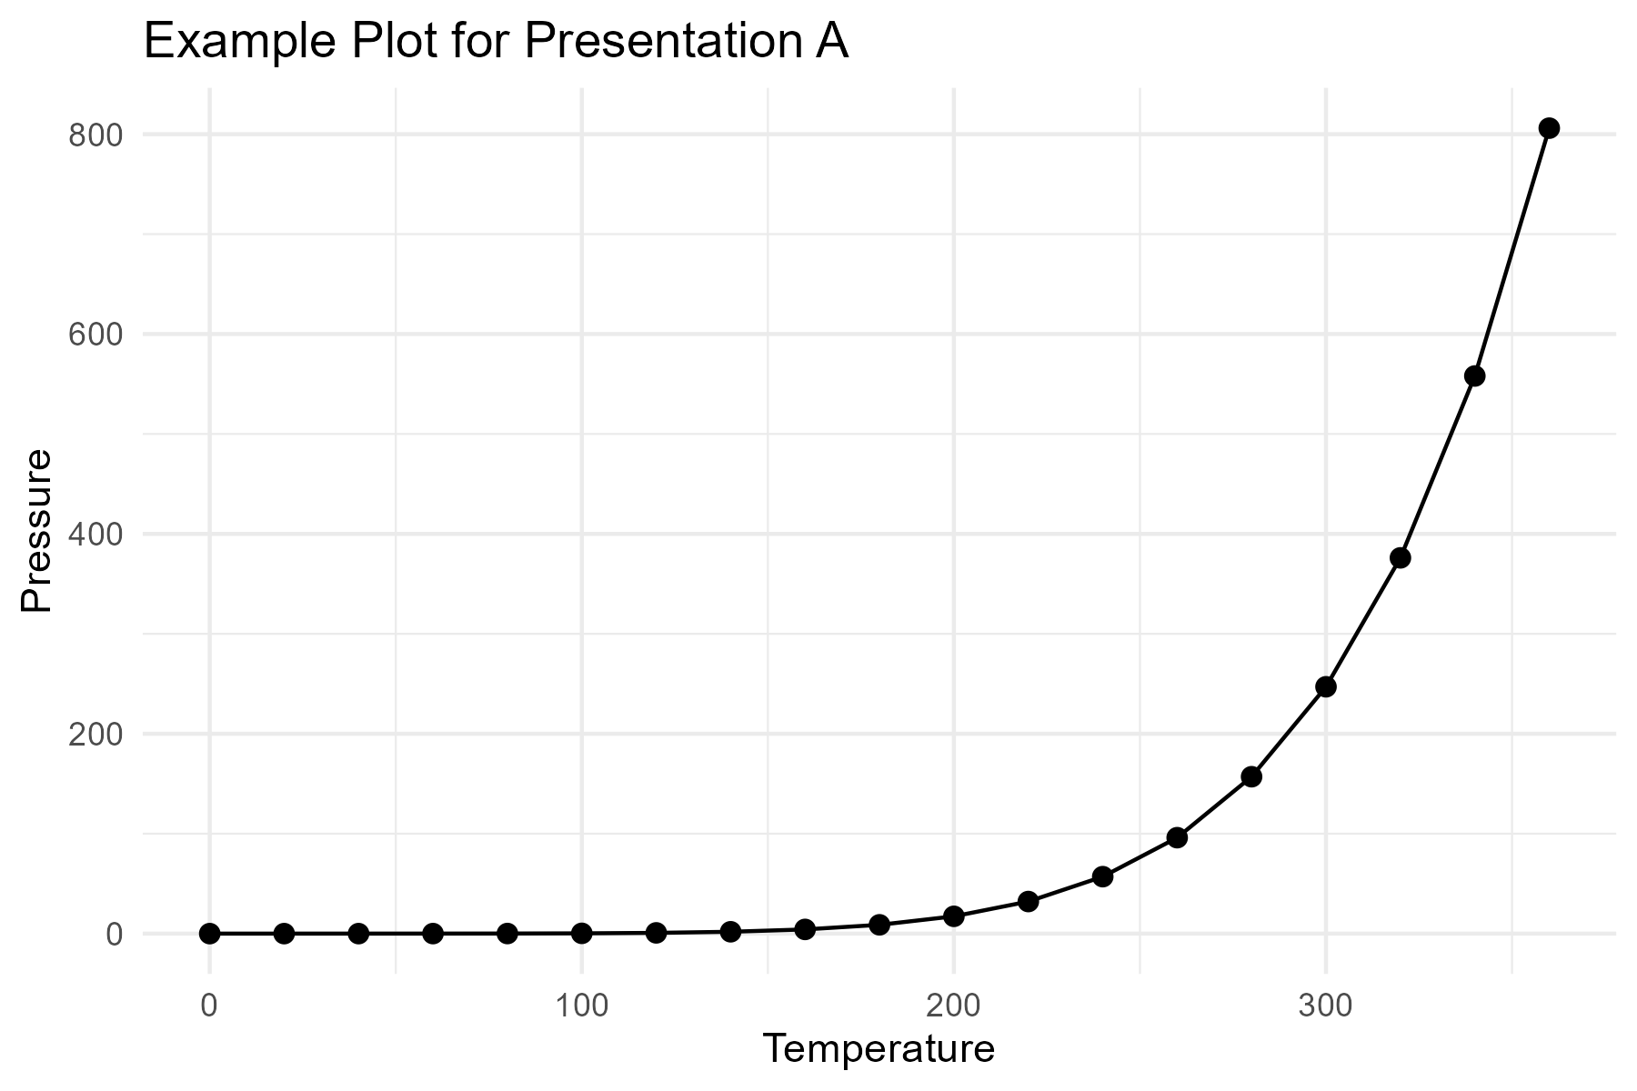
Example Plot A

Slide 33
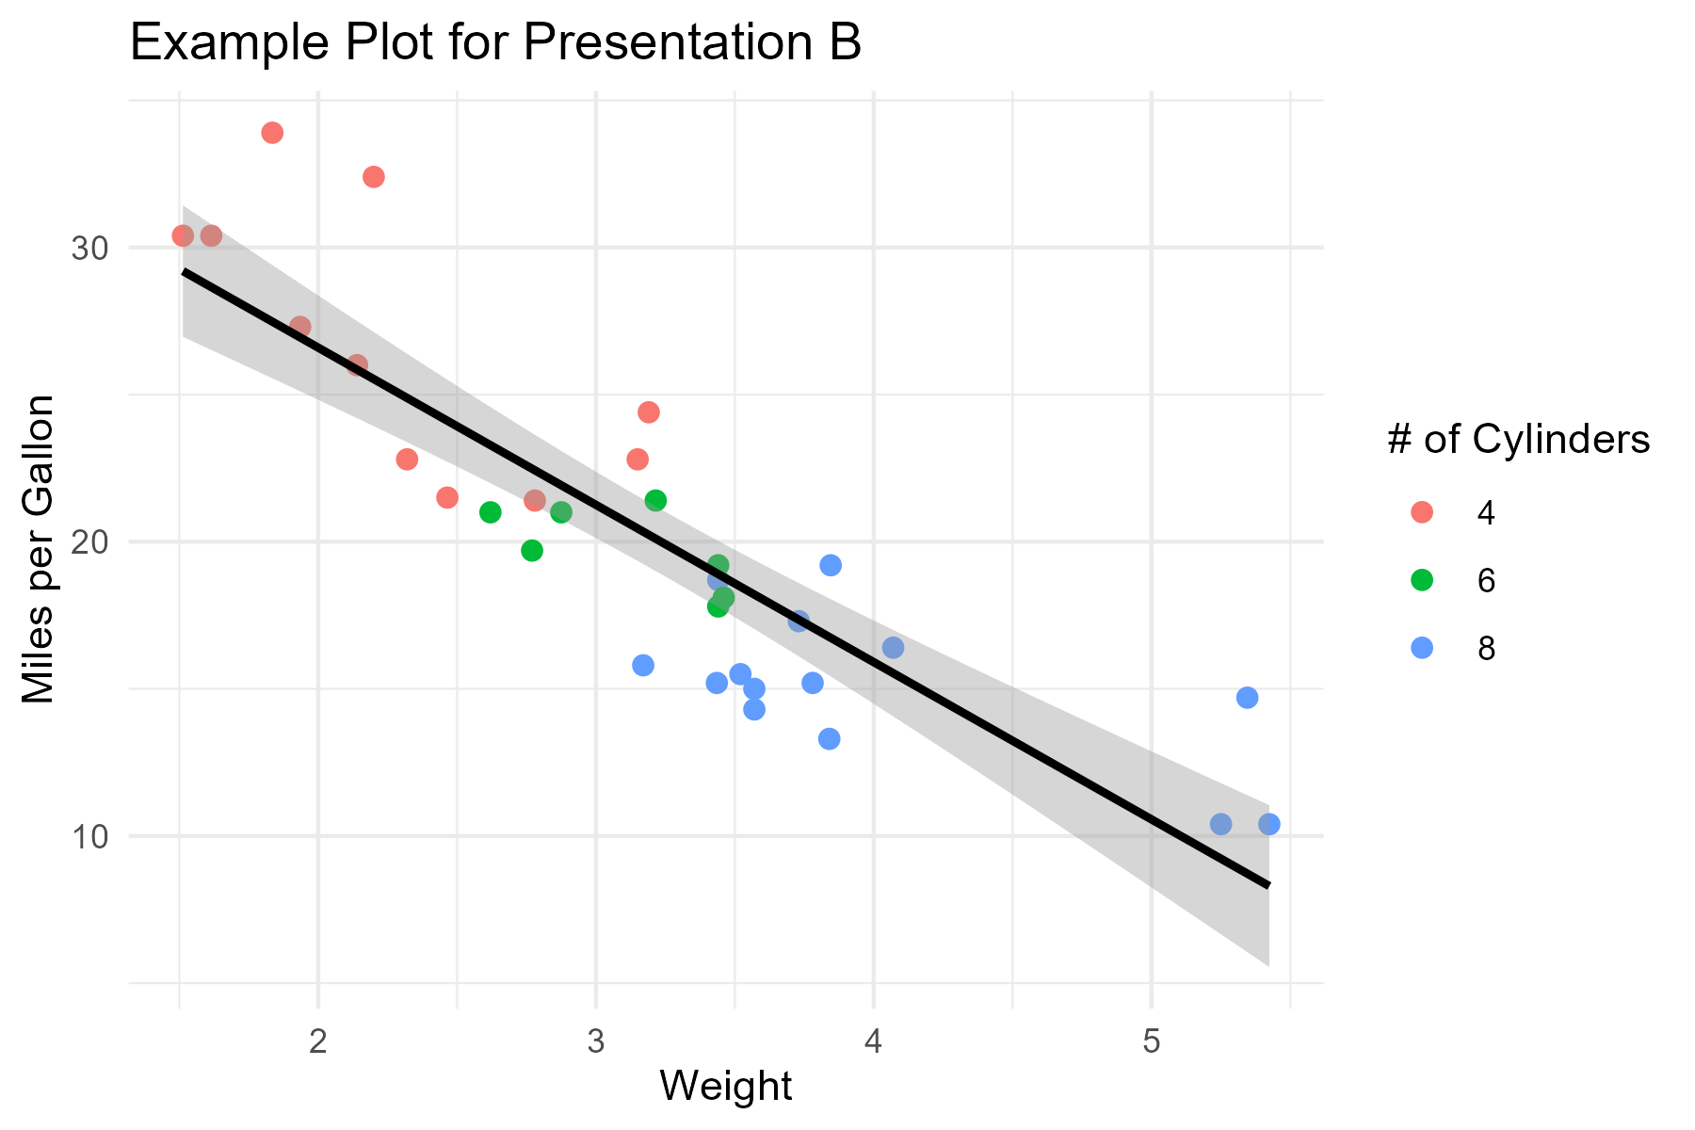
Example Plot B

Slide 34
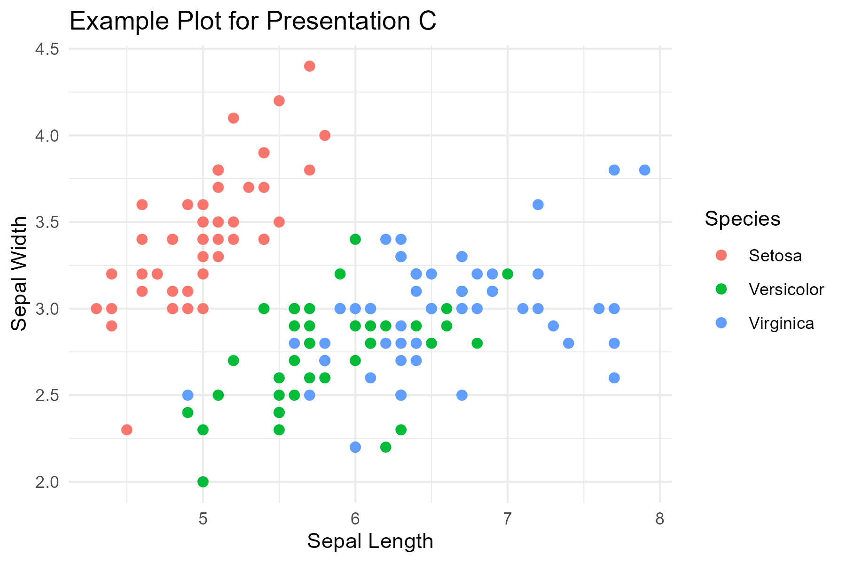
Example Plot C

